Slide 1
Django
Hello World App
Material in these slides was taken from DJANGO for Beginners – William S. Vincent

Slide 2
How the Internet Works
Computer science students typically take an entire course devoted to Network Communication, and there are network engineers who focus their careers on this one area.
For our purposes as web developers, a general understanding is sufficient to get started.

Slide 3
When you request a website like learndjango.com, your web browser first asks the DNS (Domain Name System) to translate the domain name into an IP (Internet Protocol) address, a unique numerical identifier computers use to find one another across the Internet.
Once the web browser knows the IP address, it establishes a network connection with the server at that IP address containing the contents of the desired website.
The browser sends an HTTP request for the desired resource (e.g., the homepage) and the server returns an HTTP response with its contents.

Slide 4
HTTP (Hypertext Transfer Protocol) is the set of rules computers use to communicate with one another over the Internet to power websites.
A protocol, in computer science, a set of rules or procedures for transmitting data between electronic devices, such as computers. In order for computers to exchange information, there must be a preexisting agreement as to how the information will be structured and how each side will send and receive it.
The HTTP methods are POST, GET, PUT, HEAD, DELETE and PATCH.

Slide 5
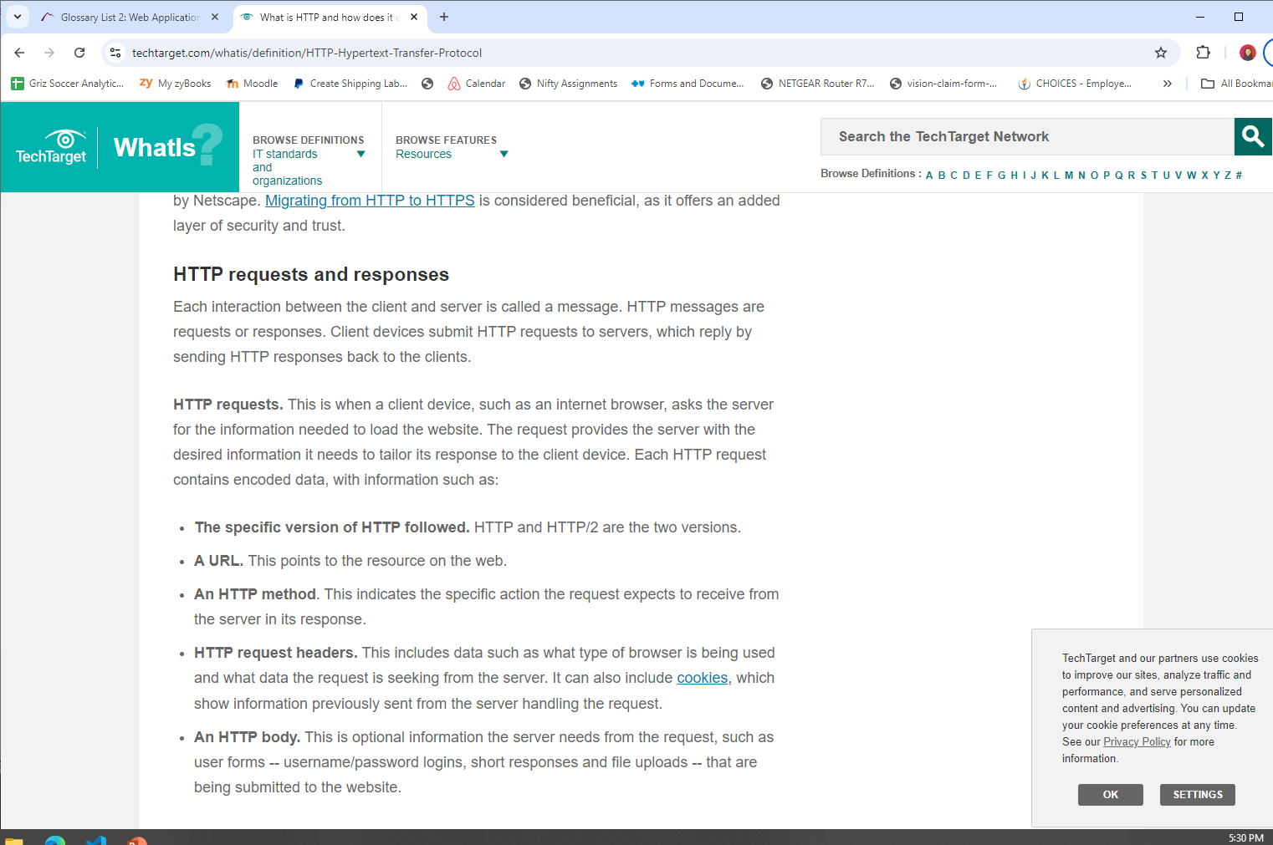

Slide 7
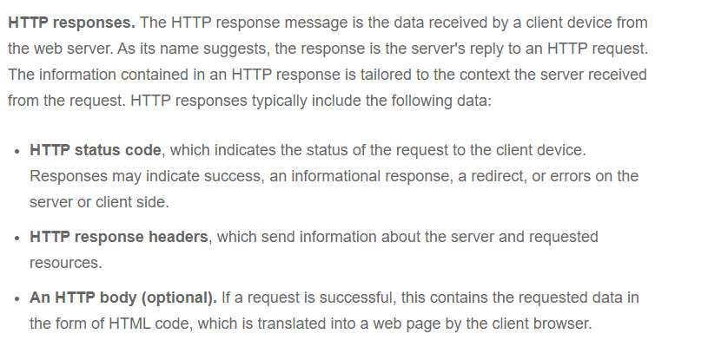

Slide 8
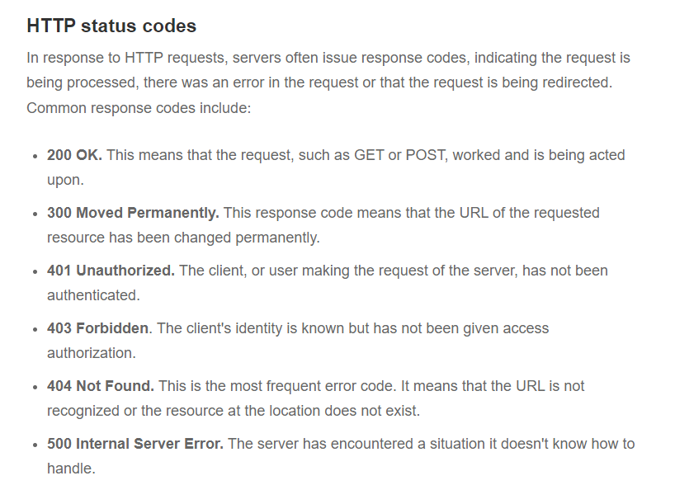

Slide 9
The full domain name for a website like LearnDjango.com is actually https://learndjango.com. The https:// at the beginning specifies that we are using HTTP as our protocol: HTTPS is the encrypted version of HTTP and now accounts for the majority of web traffic. Modern web browsers will automatically add this on for you so most regular users simply type the domain name and are unaware of the HTTP underpinnings.

Slide 10
Websites come in two basic categories: static and dynamic. A static website consists of individual HTML documents where if your website has ten pages, you need ten individual HTML documents that can be served. This approach only works for very small sites.
Most websites are dynamic, consisting of a database, HTML templates, and an application server that can generate files before sending them to your browser. With a dynamic website, a relatively small amount of code can generate hundreds or even thousands of web pages. Web frameworks like Django are designed for dynamic websites.

Slide 11
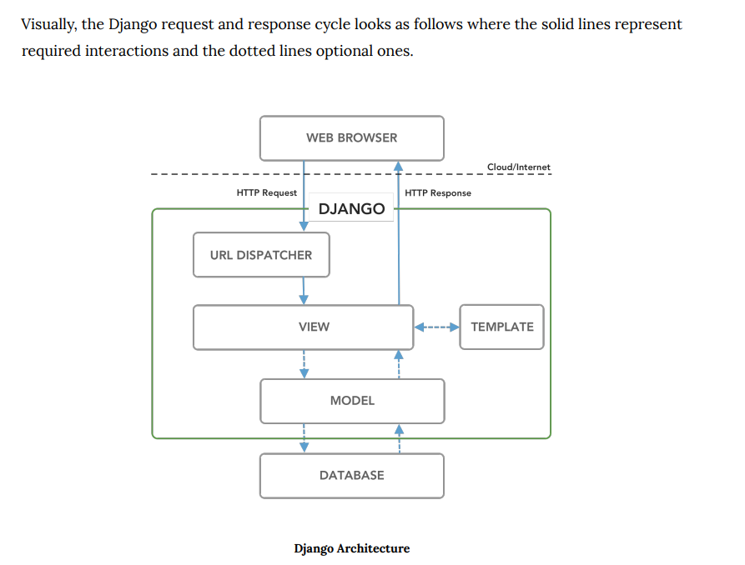

Slide 12
When an HTTP Request comes in from a Web Browser the first part of Django it engages with is the URL Dispatcher (urls.py file), which searches through configured URL patterns and stops at the first matching View (views.py file).
For a database-backed website, the View will interact with the Model (models.py file), which defines database tables, behaviors, and supports queries from the Database. This data is then sent back to the View, which in most cases then sends it to a Template for rendering. The Template is primarily an HTML file but can be in any text-based format, including XML and JSON. Once the View has all the necessary information, it returns an HTTP Response to the Web Browser. This Django request/response cycle repeats for each new HTTP Request made by the Web Browser

Slide 13
Django is designed for dynamic websites and abstracts away much of the difficulty inherent in creating a website from scratch. If you think about it, most websites require the same fundamental tools:
a way to process URL requests
a way to connect to a database
a way to generate dynamic content by filtering data from the database
a way to create templates for styling HTML and adding CSS, images, etc as needed

Slide 14
Model-View-Controller (MVC)
If you have built websites before you might be familiar with the Model-View-Controller (MVC) pattern. It is used by web frameworks including Ruby on Rails, Spring (Java), Laravel (PHP), and ASP.NET (C#).
This is a popular way to internally separate the data, logic, and display of an application into separate components that are easier for a developer to reason about.

Slide 15
Model-View-Controller (MVC)
In the traditional MVC pattern there are three major components:
Model: Manages data and core business logic
View: Renders data from the model in a particular format
Controller: Accepts user input and performs application-specific logic

Slide 16
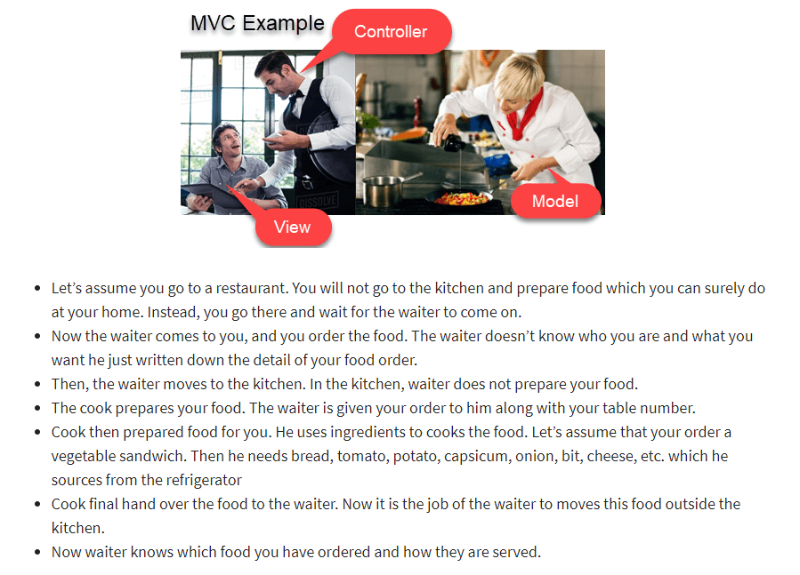

Slide 17
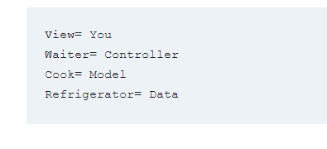

Slide 18
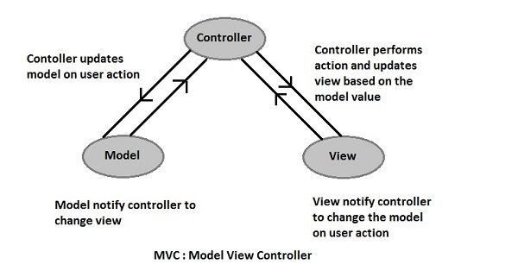

Slide 19
Benefits of MVC pattern
Separation of concerns:
The separation the three components, allows the re-use of the business logic across applications.
Multiple User Interfaces can be developed without concerning the codebase.
Developer specialization and focus:
The developers of UI can focus exclusively on the UI screens without bogged down with business logic.
The developer of Model / business can focus exclusively on the business logic implementations, modifications, updates without concerning the look and feel.
Parallel development by separate teams:
Business logic developers can build the classes, while the UI developers can involve in designing UI screens simultaneously, resulting the interdependency issues and time conservation.
UI updates can be made without slowing down the business logic process.

Slide 20
Model-View-Template
Django’s approach is sometimes called Model-View-Template (MVT) but it is really a 4-part pattern that also incorporates URL configuration. Something like Model-View-Template-URL (MVTU) would be a more accurate description:
Model: Manages data and core business logic
View: Describes which data is sent to the user but not its presentation
Template: Presents the data as HTML with optional CSS, JavaScript, and static assets
URL Configuration: Regular expression components configured to a View

Slide 21
The “View” in MVC is analogous to a “Template” in Django while the “Controller” in MVC is divided into a Django “View” and “URL dispatcher.”

Slide 22
When you type in a URL, such as https://djangoproject.com, the first thing that happens within our Django project is that runserver kicks into gear and helps Django look for a matching URL pattern (contained in urls.py).
The URL pattern is linked to a single view (contained in views.py) which combines the data from the model (stored in models.py) and the styling from a template (any file ending in .html). The view then returns a HTTP response to the user.

Slide 23
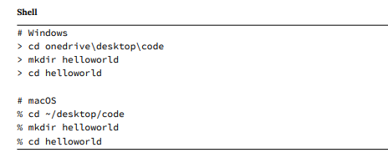
Initial Set Up

Slide 24
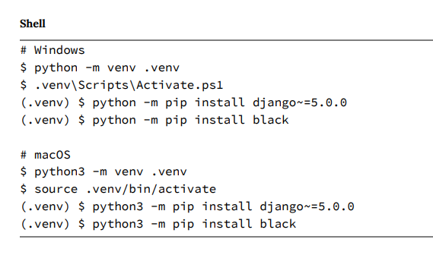

Slide 25
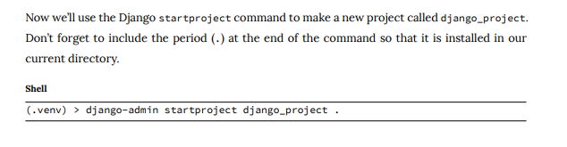

Slide 26
MAC - Note: If tree doesn’t work for you, install it with Homebrew: brew install tree
Windows Powershell: tree (just folders) tree /F (folders and files)

Slide 27
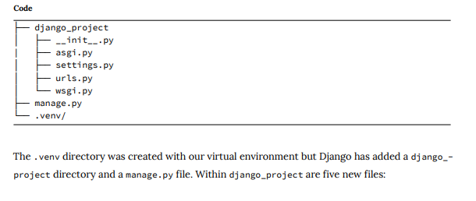

Slide 28
What is a Python Script

Slide 29
What is a Python Script
A “script” is something you execute in the shell to accomplish a defined task. To write a script, you’d type your code into your favorite text editor and save it with the .py extension. You can then use the python command in a terminal to execute your script.

Slide 30
What is a Python Module

Slide 31
What is a Python Module
A module on the other hand is Python code that you import into your other programs. “Module” is really an umbrella term for reusable code.

Slide 32
What is a python package?

Slide 33
What is a python package?
A Python package usually consists of several modules. Physically, a package is a folder containing modules and maybe other folders that themselves may contain more folders and modules.
Conceptually, it’s a namespace. This simply means that a package’s modules are bound together by a package name, by which they may be referenced.

Slide 34
__init__.py
A package folder usually contains one file named __init__.py that basically tells Python: “Hey, this directory is a package!” The init file may be empty, or it may contain code to be executed upon package initialization.

Slide 35

WSGI & ASGI

Slide 36
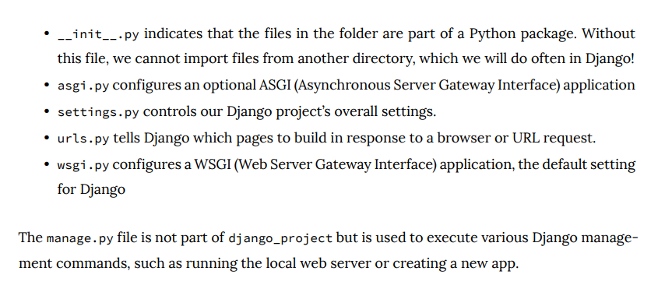

Slide 37
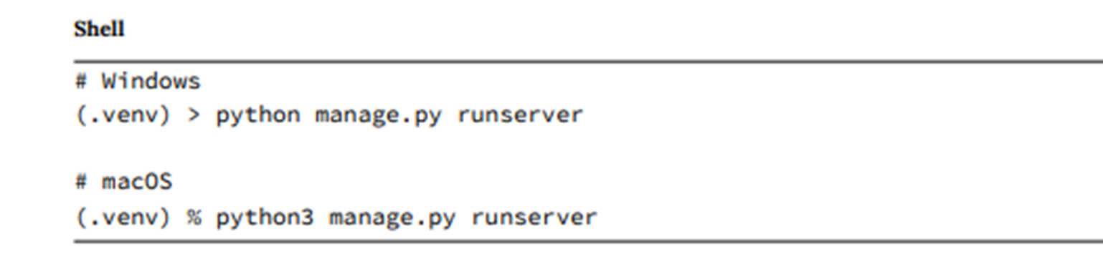
Visit http://127.0.0.1:8000 to make sure everything is running ok

Slide 38
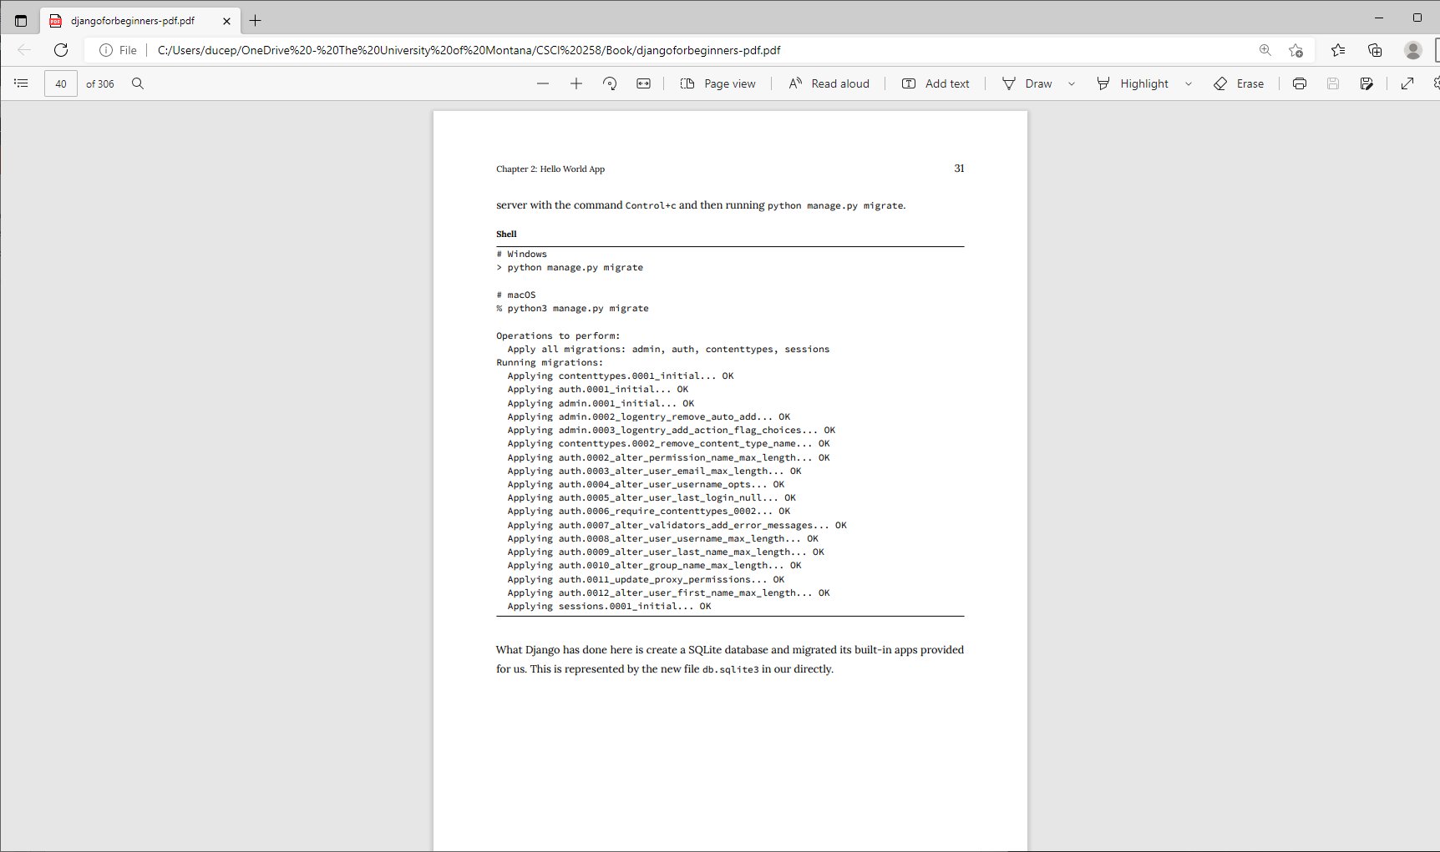
To remove migration warnings:
Stop server (ctrl c)

Slide 39
Create An App
Django uses the concept of projects and apps to keep code clean and readable.
A single top-level Django project can contain multiple apps. Each app controls an isolated piece of functionality. For example, an e-commerce site might have one app for user authentication, another app for payments, and a third app to power item listing details. That’s three distinct apps that all live within one top-level project. How and when you split functionality into apps is somewhat subjective, but in general, each app should have a clear function.

Slide 40
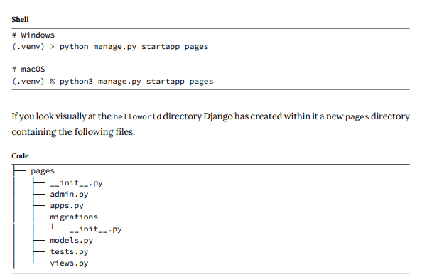
Quit the server Control+c

Slide 41
Let’s review what each new pages app file does:
admin.py is a configuration file for the built-in Django Admin app
apps.py is a configuration file for the app itself
migrations/ keeps track of any changes to our models.py file so our database and models.py stay in sync
models.py is where we define our database models which Django automatically translates into database tables
tests.py is for our app-specific tests
views.py is where we handle the request/response logic for our web app

Slide 42
Even though our new app exists within the Django project, Django doesn’t “know” about it until we explicitly add it. Open the django_project/settings.py file and scroll down to INSTALLED_APPS where you’ll see six built-in Django apps already there.
Add pages at the bottom.

Slide 43
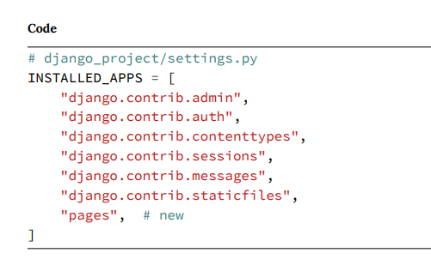

Slide 44
URLs, Views, Models, Templates
In Django, four separate files aligning with this MVT pattern are required to power one single dynamic (aka linked to a database) webpage:
models.py
views.py
template.html (any HTML file will do)
urls.py

Slide 45
However, to create a static webpage (not linked to a database) we can hardcode the data into a view so the model is not needed.
We’ll create a static page for our first website that outputs the text “Hello, World!” This page does not involve a database or even a template file. Instead, it is a good introduction to how views and URLs work within Django.

Slide 46
A view is a Python function that accepts a Web request and returns a Web response.
The response can be the HTML contents of a Web page, a redirect, a 404 error, an image, or almost anything.
When a web page is requested, Django automatically creates a HttpRequest object that contains metadata about the request.
Then Django loads the appropriate view, passing HttpRequest as the first parameter to the view function. The view is ultimately responsible for returning an HttpResponse object

Slide 47
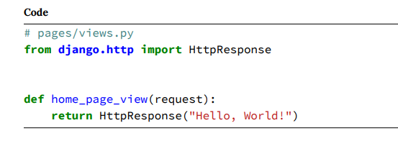
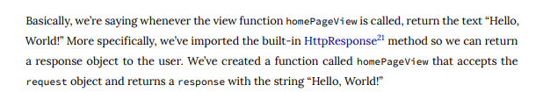

Slide 48
There are two types of views in Django: function-based views (FBVs) and class-based views (CBVs). Our code in this example is a function-based view: it is relatively simple to implement and explicit.
Django originally started with only FBVs but over time added CBVs which allow for much greater code reusability, keeps things DRY (Don’t-Repeat-Yourself), and can be extended via mixins. The additional abstraction of CBVs makes them quite powerful and concise, however it also makes them harder to read for Django newcomers.

Slide 49
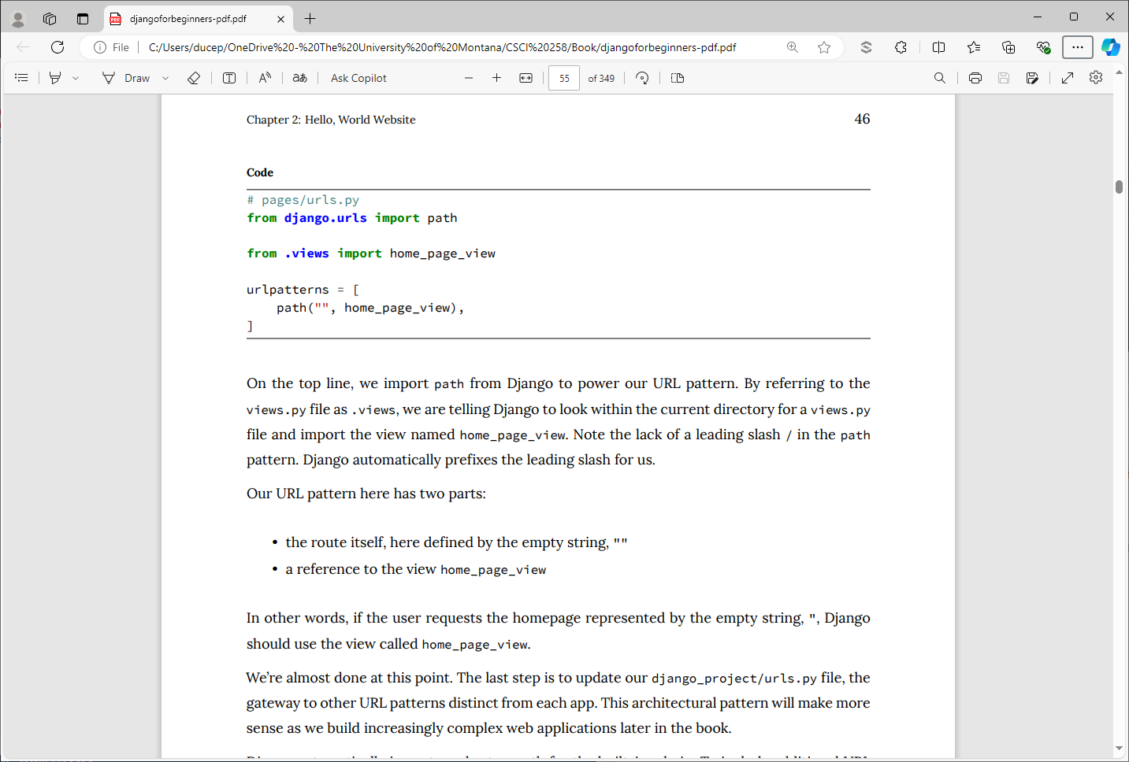

Slide 51
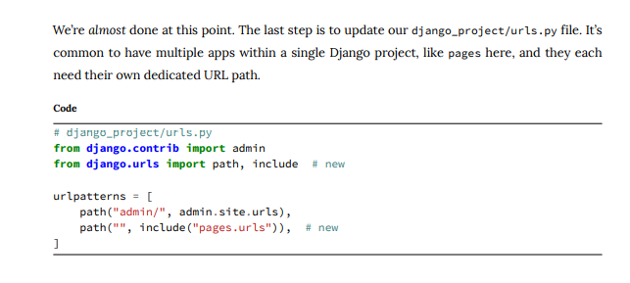

Slide 52
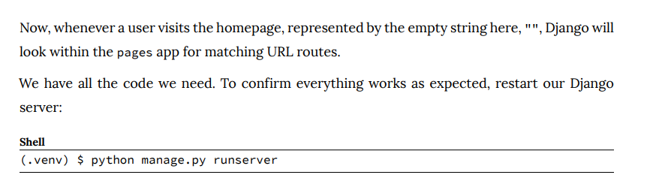

Slide 53
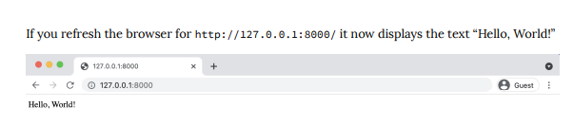

Slide 54
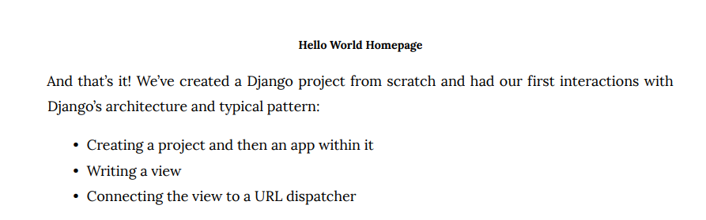

Slide 55
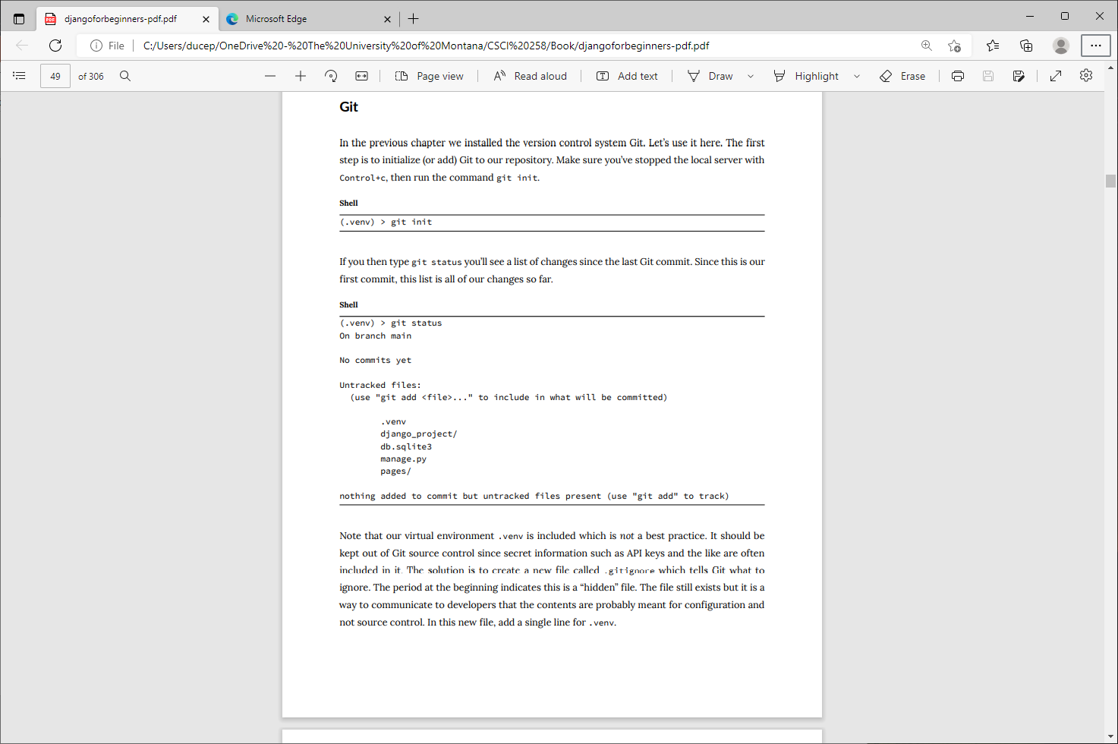
Git

Slide 57
Note that our virtual environment .venv is included which is not a best practice. It should be kept out of Git source control since secret information such as API keys and the like are often included in it. The solution is to create a new file called .gitignore which tells Git what to ignore.
The period at the beginning indicates this is a “hidden” file. The file still exists but it is a way to communicate to developers that the contents are probably meant for configuration and not source control. In this new file, add a single line for .venv

Slide 58
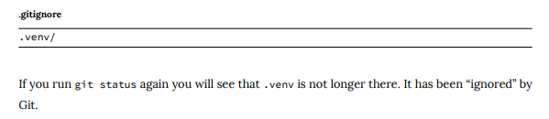

Slide 59
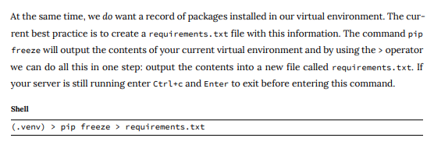

Slide 60
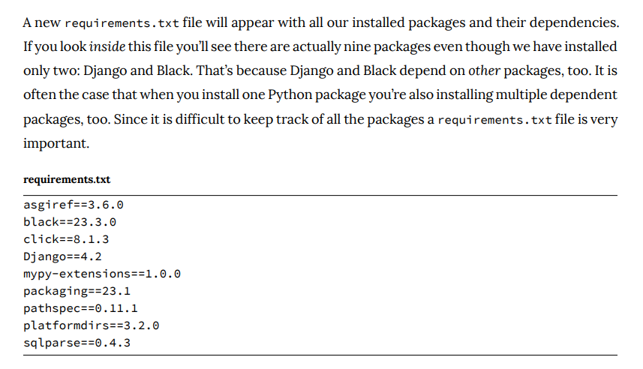

Slide 61
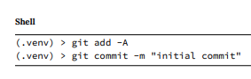
We next want to add all recent changes by using the command add -A and then commit the changes along with a message (-m) describing what has changed.

Slide 62
GitHub
It’s a good habit to create a remote repository of your code for each project. This way you have a backup in case anything happens to your computer and more importantly, it allows for collaboration with other software developers

Slide 63
We will use GitHub this semester.
Sign up for a free account on GitHub’s homepage and verify your email address. Then navigate to the “Create a new repository” page located at https://github.com/new

Slide 64
Enter the repository name hello-world. Then click on the button at the bottom for “Create Repository.”
Your first repository is now created! However there is no code in it yet. Scroll down on the page to where it says “…or push an existing repository from the command line.” That’s what we want.
Copy the text immediately under this headline and paste it into your command line.

Slide 65
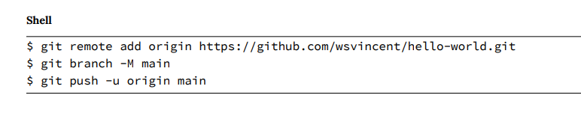

Slide 66
The first line syncs the local directory on our computer with the remote repository on the GitHub website.
The next line establishes the default branch as main which is what we want.
And then the third line “pushes” the code up to GitHub’s servers. Assuming everything worked properly, you can now go back to your
GitHub webpage and refresh it. Your local code is now hosted online!

Slide 67
